Slide 1
Sales Forecasting for Walmart
MGMT 59000 – 103 (Machine Learning)
Submitted by: Data Jedi
Sathwik Kanukuntla
Sohan Kumar Sahoo

Slide 2
Business Objective
“The objective is to predict daily sales for Walmart over the next 28 days, using detailed sales data from multiple stores and factors like promotions like SNAP, seasonality parameters, and special events to enhance accuracy.”

Slide 3
Data hierarchy at glance
Texas
3 stores
Food
Hobbies
California
Wisconsin
House
4 stores
3 stores
3 stores
2260 Products

Slide 4
Data Description
Sales Data overview
Original: 30490 products, 10 stores, 3 categories, 3 states
In-Scope: 2260 products, 3 stores, 1 category (Hobbies), 1 state (Cali.)
Data at glance
Date Range
Original: May 2011 – April 2016
In-Scope: Jan 2014 – April 2016
Calendar events
Describes date, week, months, events, SNAP, etc.
Sell Prices
Selling prices of Products across all categories

Slide 5
Methodology
Datasets
EDA
Data acquired from Kaggle and data dictionary is prepared
Check if there is any trend across multiple scenarios
Data Preprocessing
Check and treat nulls, outliers, and review features
Data Modelling
Model data preparation
Creation of predictor and target variables
Expand this pre-model across training, validation, and test data
Designing architecture
LSTM
LSTM + CNN
Evaluation on test data based on MAPE and RMS (KPIs)

Slide 6
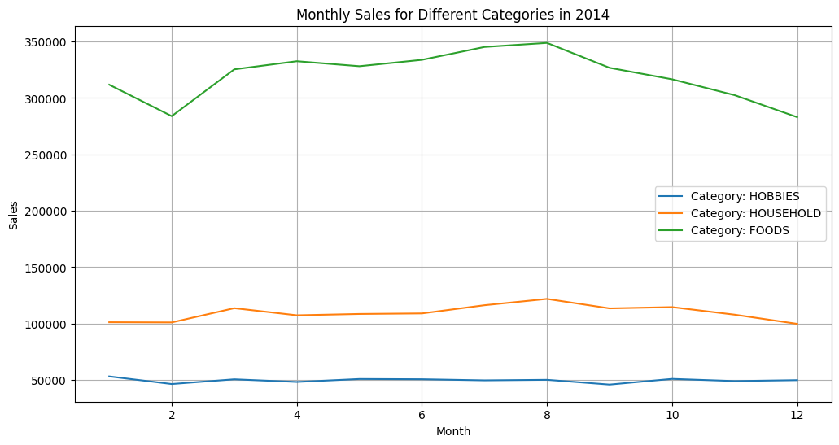
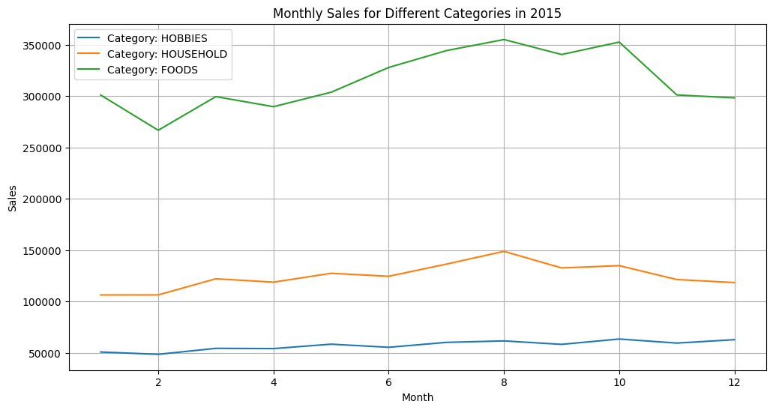
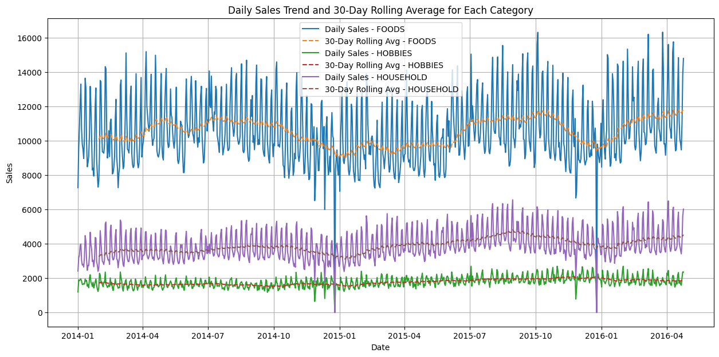
EDA (1/3)
Peak sales month has remained same across 3 categories
Monthly sales 2014
Monthly sales 2015
Rolling Average for 30-day

Slide 7
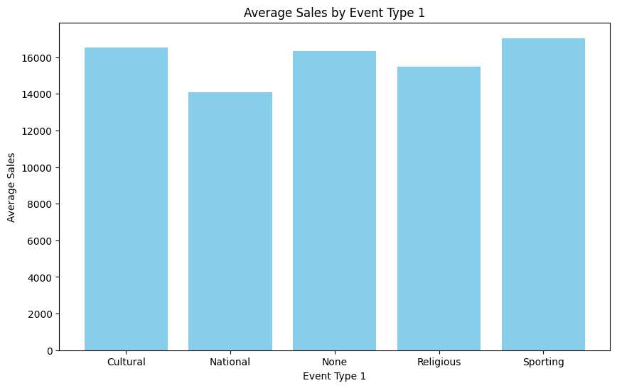
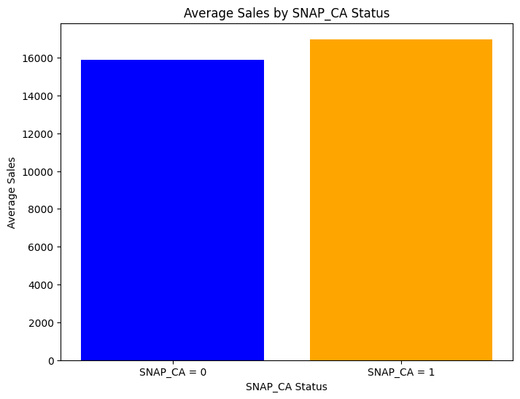
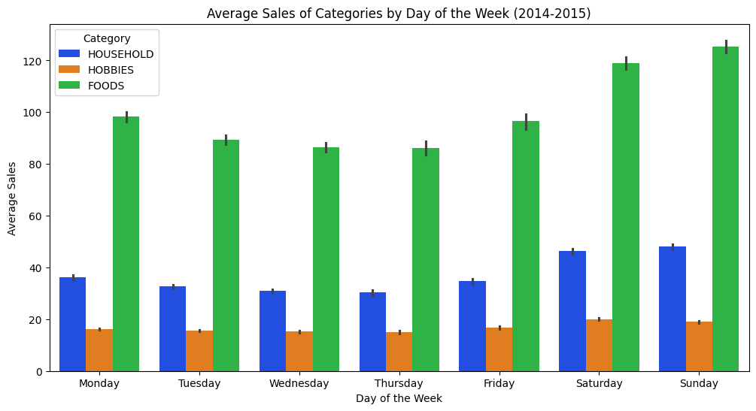
EDA (2/3)
Avg. Sales - Event type
Average Sales is higher when there is sports or cultural events
Some stores may be closed on national or religious holidays due to which Avg. Sales declined
Avg. Sales - SNAP
Average Sales during SNAP days is higher
Avg. Sales - Event type
Average Sales is higher during weekends

Slide 8
EDA (3/3)
Data array in scope
No Null Values
Null Values
(2260, 879)
Sales entries are non-zero across all the entries
Calendar value has null values for event_type

Slide 9
Data Preprocessing
01
Check for nulls
“CLEAN DATA IS ALL WE NEED”
Replace null values
02
Check for null value proportion for Sales orders and features
Replace null values like Nan in calendar as level – “None”
Multiple Iterations
03
Treat Outliers
Create Dummy Variables - 1
04
Create dummy variables for SNAP
Outliers above 75th percentile are capped
Replace –ve sales to zero
05
Create Dummy Variables - 2
Normalization
06
Create cyclical feature variables for weekday and month
Normalization of sales orders while ensures the values are capped in (0,1)
07
Lag Feature Creation
Data frame Transpose
08
This lag feature considers the fact that sales increases 1-2 days before any event
Transpose to ensure row represents sales for a particular day for all 2260 products

Slide 10

Predictor and Target data preparation
Time Sequence from 0 to T
Y_{t+28}
Y_{t+29}
Y_{t+30}
Y_{T}
X_{t}
t
t^{th} day
X_{t+1}
(t+1)^{th} day
X_{t+2}
(t+27)^{th} day
(t+2)^{th} day
t +27
(t+28)^{th} day
t+28th day
(t+29)^{th} day
t+29th day
Y_{t+28}
t+30th day
t +30
Y_{t+29}
X_{T}
Y_{t+30}
Formula for each entry prediction based on previous 28 days
X -> Predictor
Y-> Target
(T-28)^{th} day
(T- 1)^{st} day
T^{th} day
T
Number of Iterations (N-28)
Y_{T}

Slide 11
Data Modelling Approaches Followed
01
02
Without Lag Features
With Lag Features
Ignoring the fact that sales happen 1-2 days before the event day
Assuming the fact that sales happen 1-2 days before the event day

Slide 12
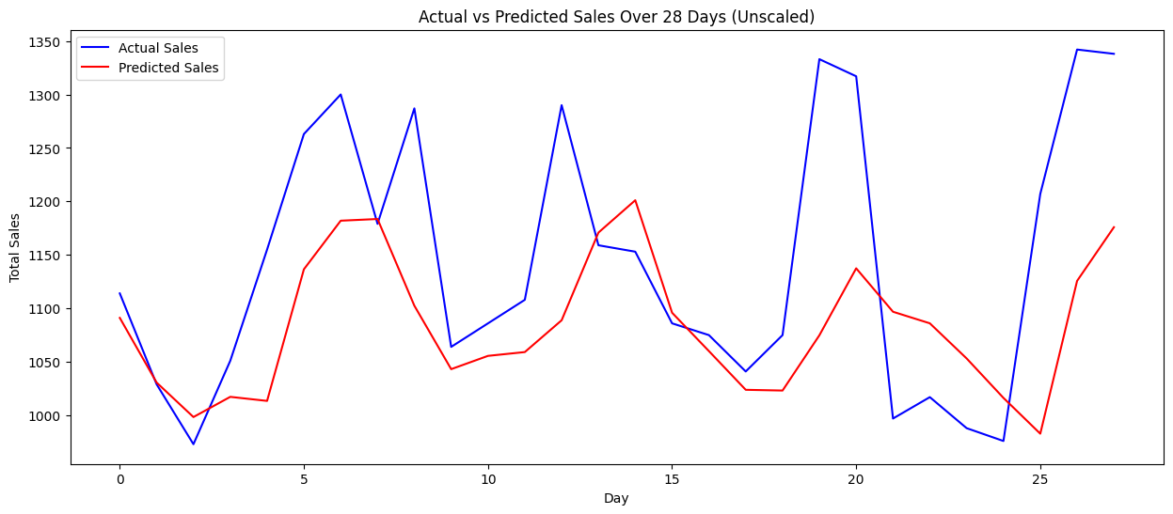

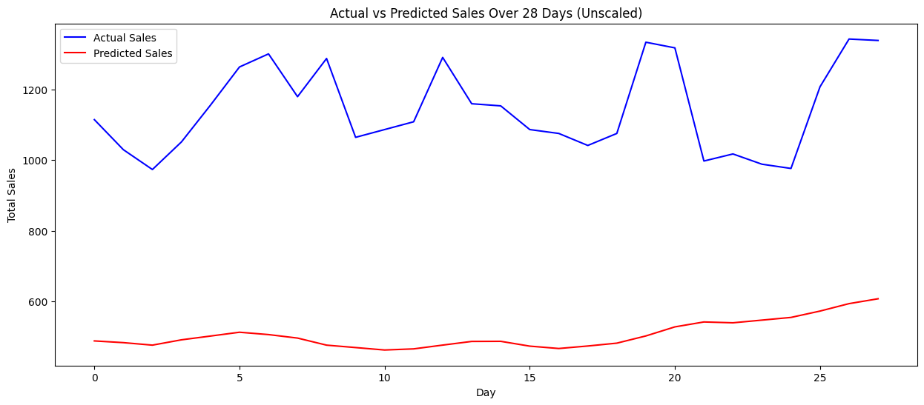
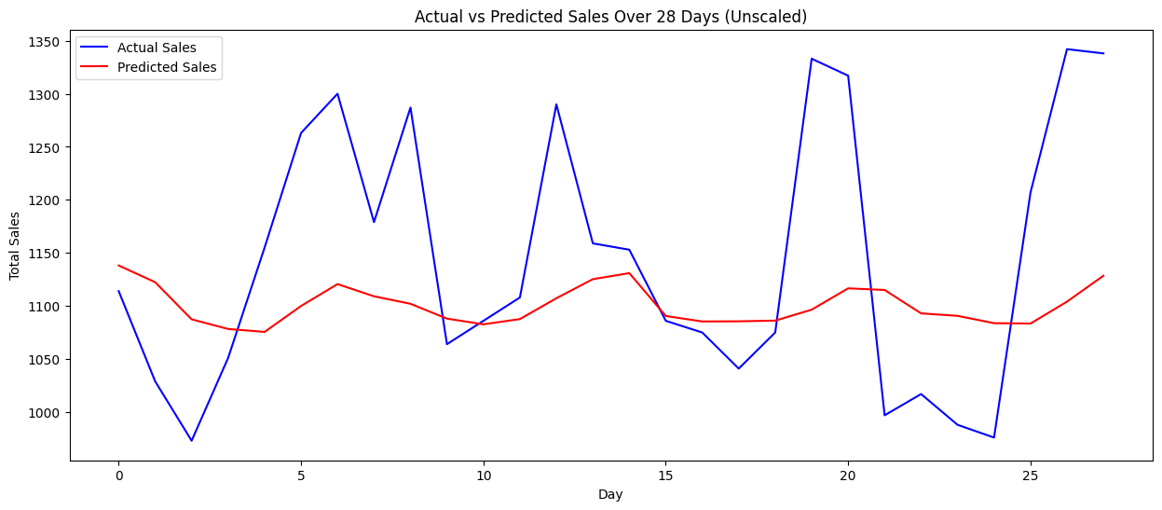
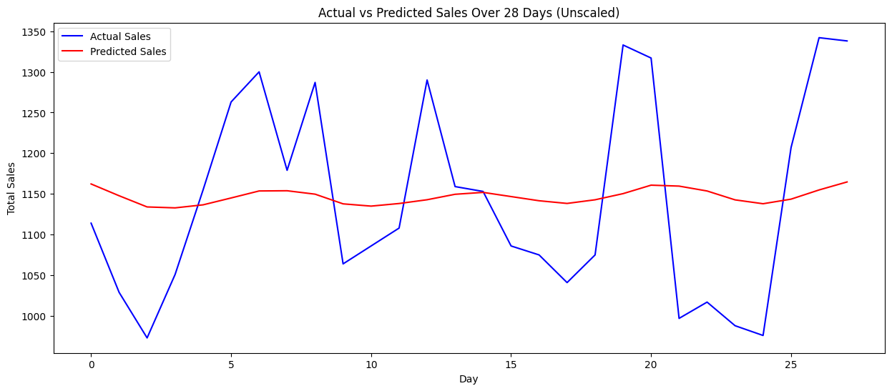
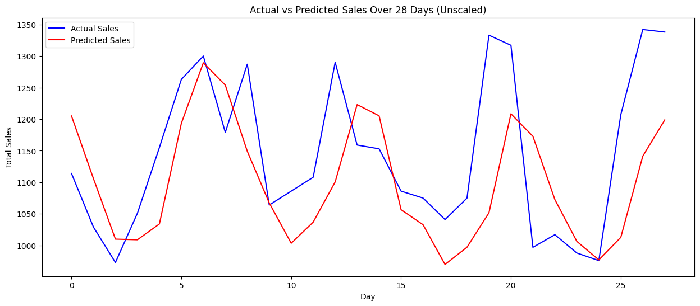
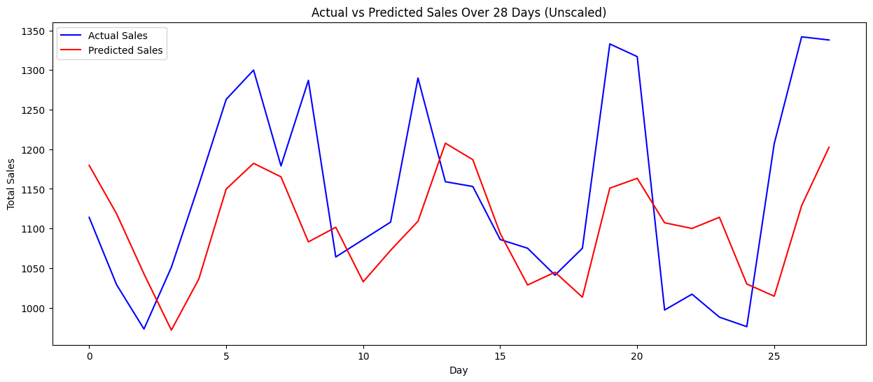
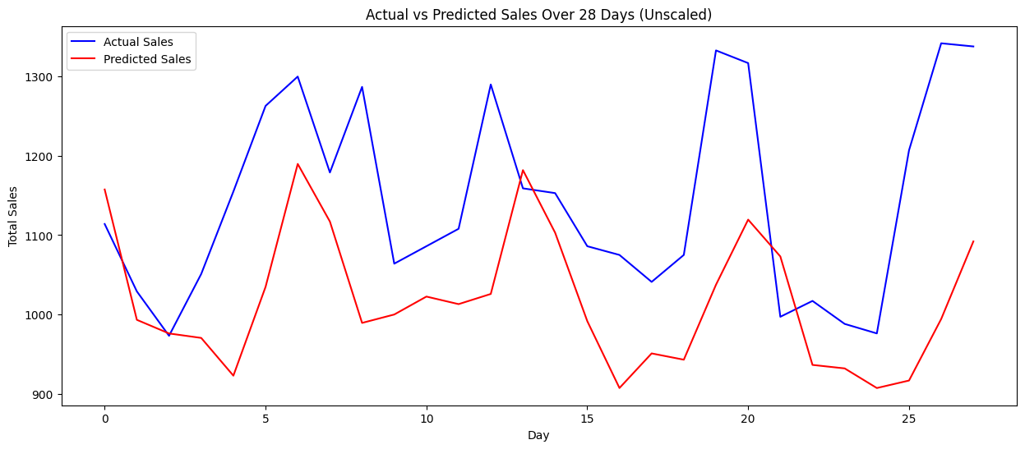
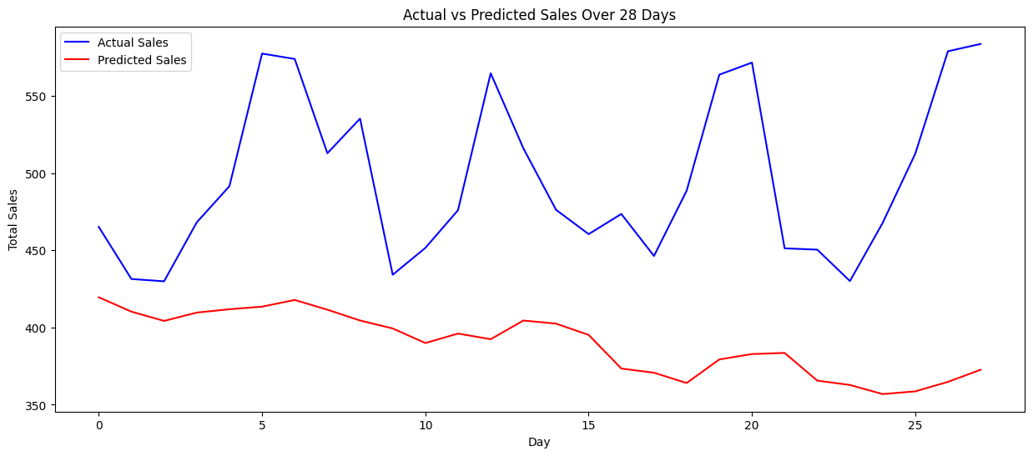
Model Summary
Model | MAPE | RMS | Architecture | Key Parameters experimented | Seasonality
Model 1 | 55.153% | 0.9226 | 2 * Bi- LSTM * 100 N + 1 Dense * 100 N + ReLu | Adam Optimizer with learning rate 0.01 Dropout – 0.3
Model 2 | 74.640% | 1.139 | 2 * Bi- LSTM * 100 N + 1 Dense * 150 N + ReLu | Adam Optimizer with learning rate 0.01 Dropout – 0.4 l1, l2 regularized
Model 3 | 54.876% | 0.927 | 2 * Bi- LSTM * 150 N + 1 Dense * 150 N + ReLu | Adam Optimizer with learning rate 0.01 Dropout – 0.4
Model 4 | 54.207% | 0.934 | CNN (64 filters) + 2 * Bi- LSTM * 100 N + 1 Dense * 100 N + ReLu | Adam Optimizer with learning rate 0.005 Dropout – 0.3 LearningRateScheduler
Model 5 | 54.809% | 0.9280 | CNN (64 filters) + 2 * Bi- LSTM * 100 N + 1 Dense * 100 N + ReLu | Adam Optimizer with learning rate 0.001 Dropout – 0.3 LearningRateScheduler
Model 6 | 55.05% | 0.9279 | 2 * CNN (128 filters) + 2 * Bi- LSTM * 100 N + 1 Dense * 100 N + ReLu | Adam Optimizer with learning rate 0.005 Dropout – 0.3 ReduceLROnPlateau
Model 7 | 56.42% | 0.931 | 2 * CNN (128 filters) + 2 * Bi- LSTM * 200 N + 1 Dense * 200 N + ReLu | Adam Optimizer with learning rate 0.001 Dropout – 0.4 ReduceLROnPlateau
Model 8 | 58.762% | 0.952 | 2 * CNN (128 filters) + 2 * Bi- LSTM * 200 N + 1 Dense * 200 N + Leaky ReLu | Adam Optimizer with learning rate 0.001 Dropout – 0.4 ReduceLROnPlateau

Slide 13
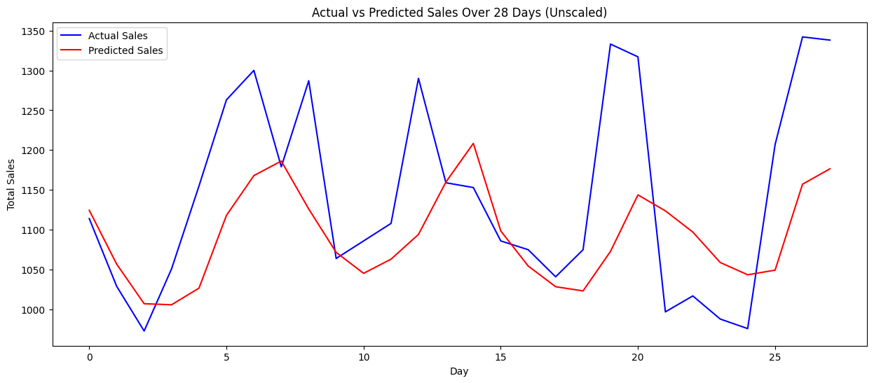


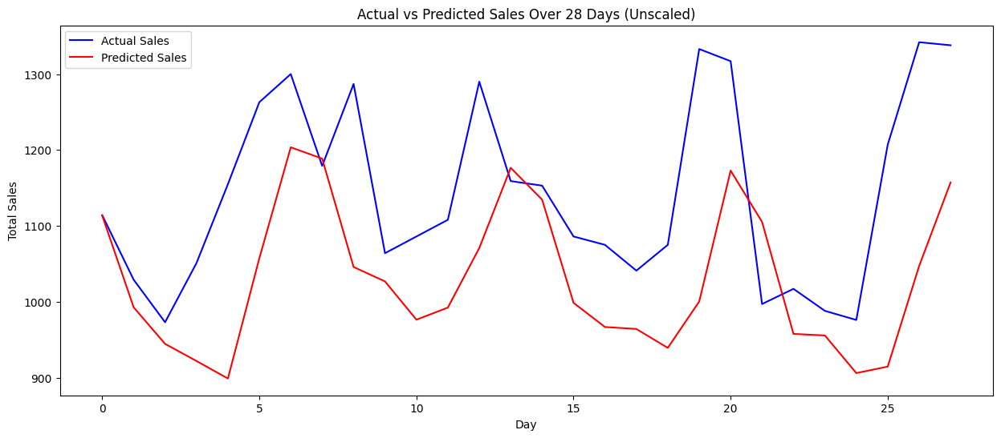
Model Summary (with lag features)
Model | MAPE | MAPE with lag | RMS | RMS with lag | Seasonality
Model 1 | 55.153% | 55.158% | 0.9226 | 0.9224
Model 5 | 54.809% | 54.23% | 0.9280 | 0.9267
Model 6 | 55.05% | 54.97% | 0.9279 | 0.9267
Model 7 | 56.42% | 56.28% | 0.931 | 0.9333

Slide 14
Future Scope
01
Model Scalability
Across all the sates and categories
Make it Scalable and accurate
02
Accuracy
Hyper parameter tuning and additional model formulations

Slide 15
Conclusion
01 | Business Objective of Sales forecasting for Walmart
 | Successfully achieved
02 | Key focus (In-scope)
 | California state, Hobbies category
03 | Deep Learning and Modelling Techniques
 | (LSTM, CNN) X (Non-LAG, LAG)
04 | KPI Metrics
 | MAPE and RMS
05 | Deliverables
 | 8 different working and scalable ML models

Slide 16
THANK YOU!

Slide 17
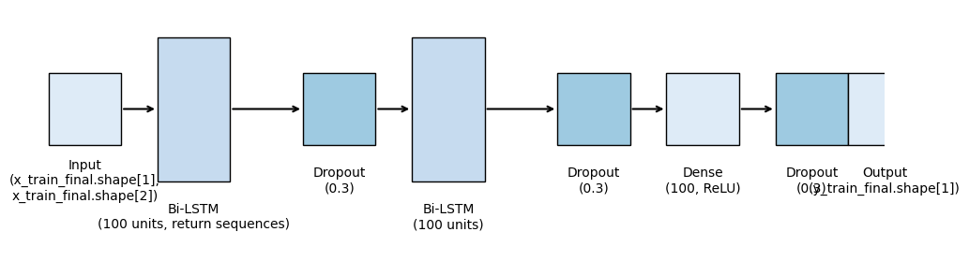
Model 1
<<Back
Next>

Slide 18
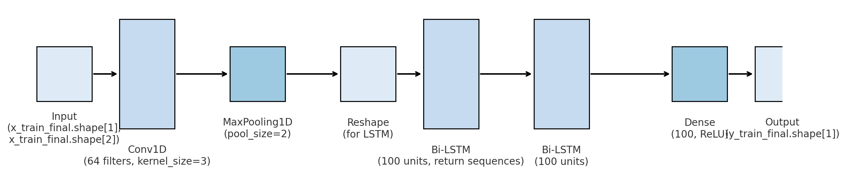
Model 5
<Previous
<<Back

Slide 19
Appendix
Link for Models code - https://colab.research.google.com/drive/1eNc3hBOaUWVRTsV3PMmhE3gdH1PCfrWh?usp=sharing
Link for Lag models code - https://colab.research.google.com/drive/1t3OtZLnfUgpK7_Uudul7f0zfPVS0r2nE?usp=sharing
Link for EDA – https://colab.research.google.com/drive/15BVPFNalIopQXzk-iKy-tIg830cK0Nhp?usp=sharing

